Slide 1
HOW WILL YOU BE A WORLD CHANGER?
PRAY Intercede on behalf of students around the world.
GIVE Supporting indigenous student ministry is one of the most effective ways of advancing God’s kingdom globally.
GO Workers are needed to minister to students, to support national movements, and to spread the IFES vision. You too can invest your time and skills in a ministry with wide- reaching impact.
Notes:
Over the next week we will be sharing some of what God has been doing in student ministry around the world. In InterVarsity, we serve God and partner with His people to extend His kingdom cross-culturally on campus and around the world. Here are some ways you can become a World Changer:
PRAY - Every night were going to share stories of students reaching out in their community, following after Jesus even in difficult places to make an impact in the world. Every night we’re going to lift up these people and situations in prayer.
GIVE - On Thursday morning we’re going to take an offering to support our IFES brothers and sisters. If every person who attends Chapter Focus Week sacrificially gives $50 we will be able to fully fund every project and every need that we’re going to learn about this week. I encourage you to prayerfully consider what you should give. Come prepared on Thursday – bring your cash, check, or credit card.
GO - There will be an opportunity on the offering envelope for you to sign up to learn more about being on mission with IFES through InterVarsity Link and Global Projects.

Slide 2
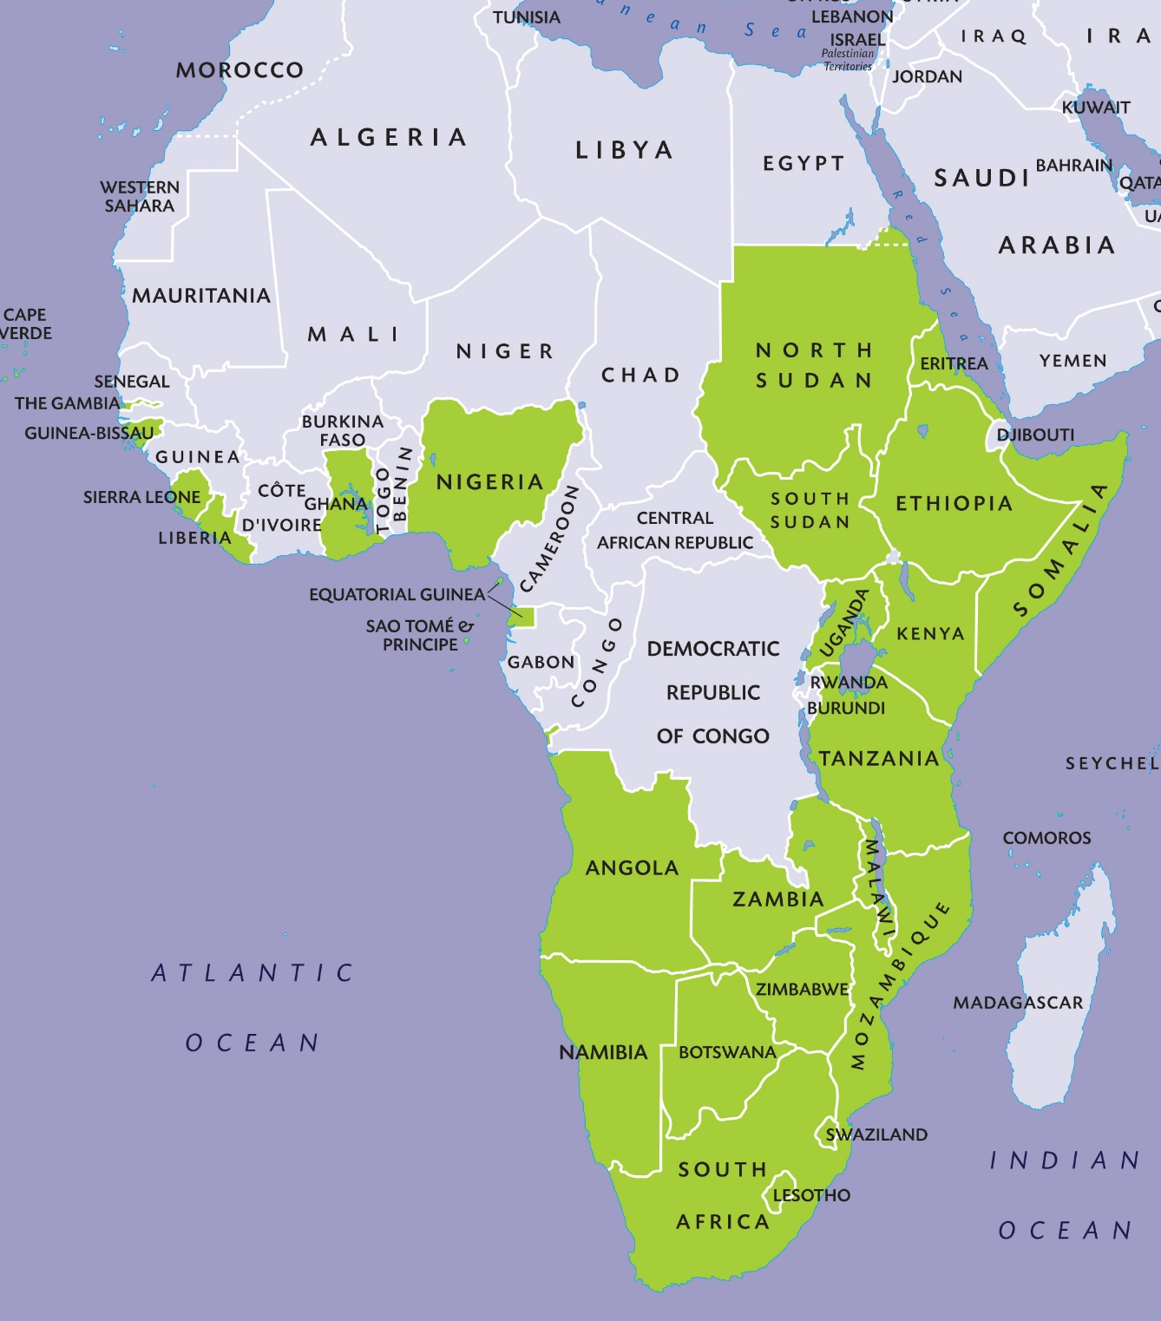
IFES Ministry in Nigeria
‘Despite the challenges, pressures and demands of student ministry, my heart leaps for joy because of what God is doing in the lives of students’ – Bala Usman
Notes:
Nigeria is Africa’s most populous country, with the second largest economy in Africa. The imposition of Islamic law in several northern states has embedded divisions and caused thousands of Christians to flee while others are learning how to live out their faith in a difficult situation.
Locally written bible studies are a great strength of the movement, and more students are now involved in leading these studies. Evangelism and prayer are also key priorities for NIFES.

Slide 3
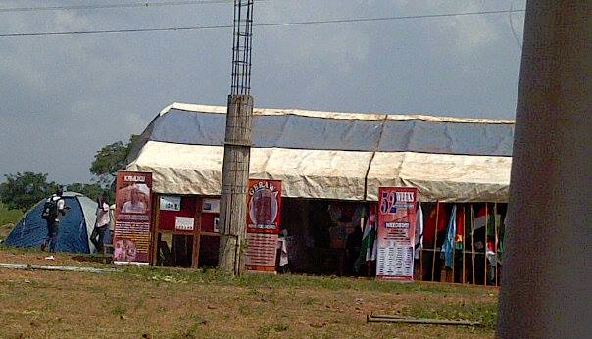
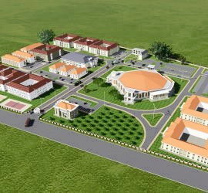
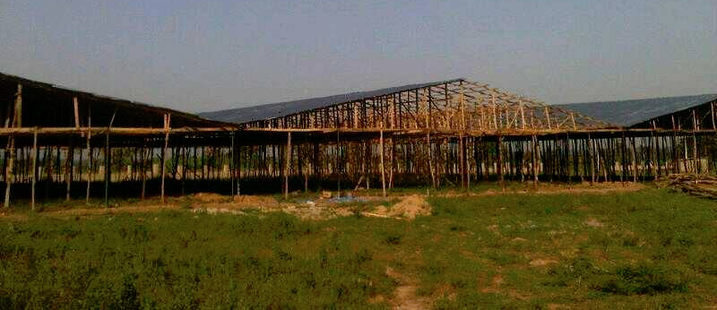
IFES Nigeria
Land of Promise
Notes:
The NIFES family began development on the NIFES Land of Promise in the year 2001. It was a humble beginning; with trees cut into flat surface woods which students used as seats during the conference and stanchions made with tarpaulin overhead as shelter/hall of meeting. Since then, we have made considerable progress little by little – with the active support of staff in giving over their salaries and students making financial commitments tied to certain projects e.g. Tent of meeting, installation of window and doors for dormitories, etc. and the full backing of Associates, donors and partners in Nigeria and overseas towards infrastructural development.
Today, the conference center has a meeting hall and four dormitories for hosting students. Other projects include installing a well, building an auditorium and constructing a fence and roads.

Slide 4
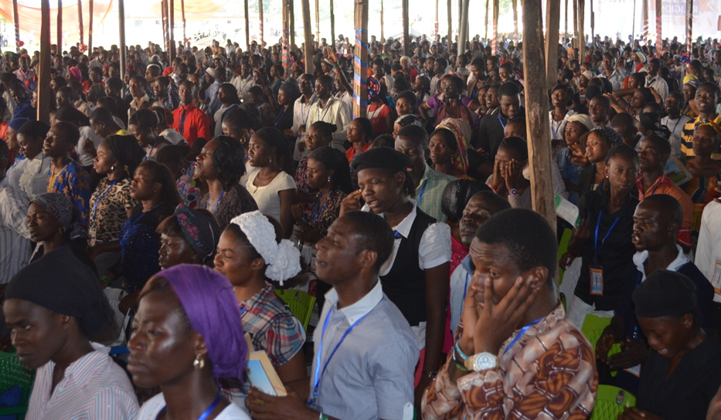
NIGERIA – Land of Promise Center
HOW CAN YOU HELP?
GIVE:
for the continued expansion and development of the Land of Promise conference center
PRAY:
for students to continue to learn what it means to engage the whole university
for the Land of Promise conference center, that it might be a blessing to many and a source of revenue for the movement.
Notes:
GIVE:
for the continued expansion and development of the Land of Promise conference center
PRAY:
for students to continue to learn what it means to engage the whole university
for the Land of Promise conference center, that it might be a blessing to many and a source of revenue for the movement.

