Slide 1
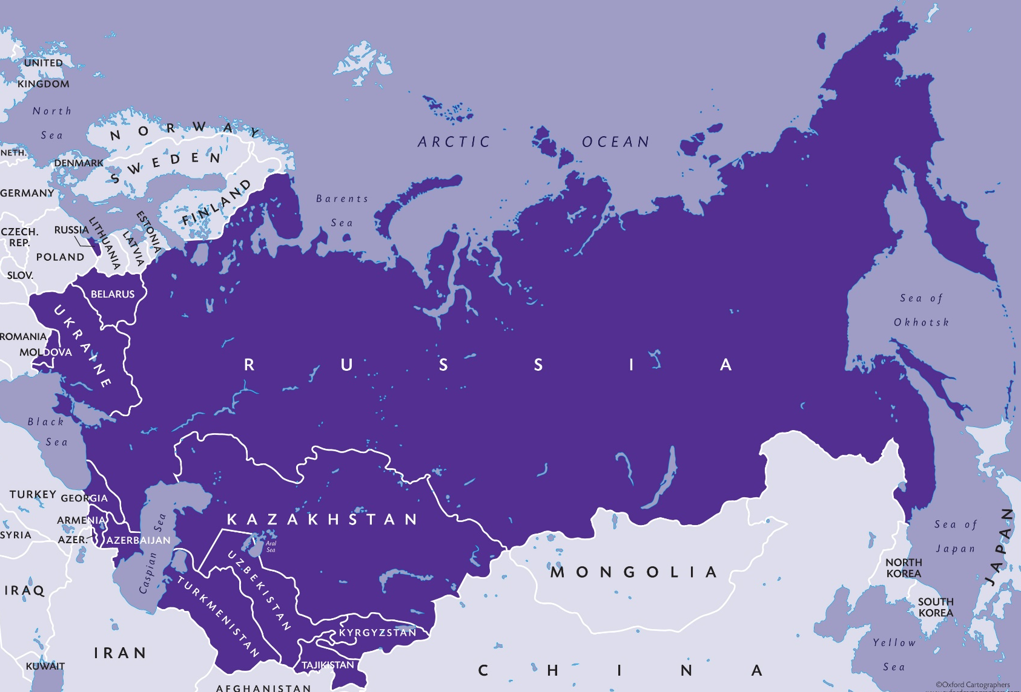
EURASIA REGION
'Building witnessing communities of Christ’s disciples is not only a Eurasian value, but also a biblical one.’
Notes:
Living as a Christian believer in the Eurasian context is very challenging as opposition can come from family, local authorities and the government. Where there is freedom student groups flourish; others struggle to exist under difficult circumstances. Generally there is no freedom to meet on campuses.
However, Eurasian movements are inching forward in growth and development, and are showing tenacity in the midst of very difficult and hostile contexts. Leadership of most movements has been turned over to nationals and the indigenous staff are owning the vision and carrying it forward in ways appropriate to each context.

Slide 2
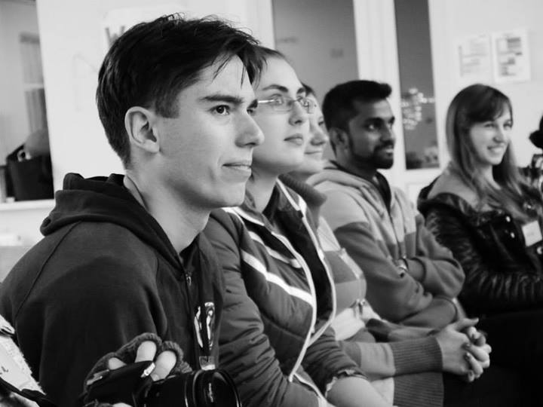
EURASIA REGION
Bible & Life
This is a three-weekend course of training for students in the basics of discipleship:
the Lordship of Christ
quiet time
friendship evangelism
studying the Bible on one’s own
leading small group Bible studies
discipling other students.
Notes:
Bible & Life is a three-weekend course of training for students in the basics of discipleship: the Lordship of Christ, quiet time, friendship evangelism, studying the Bible on one’s own, leading small group Bible studies, and discipling other students. The courses are taught creatively in community.
The first Bible & Life Level I conference in Eurasia was held in 1994 in Ukraine. Students responded so enthusiastically that the Ukrainian staff became trained as teachers of the Level II Bible study method the next year, and a Bible & Life Level II was held in late 1995. Staff and student leaders from all over Eurasia took Bible & Life back to their own countries where they adapted the course for their own country, and began to implement it there.
The manuals have been translated into Russian, Georgian, and many other Eurasian languages, and Bible & Life continues even today as a backbone of discipleship training throughout IFES Eurasia.

Slide 3
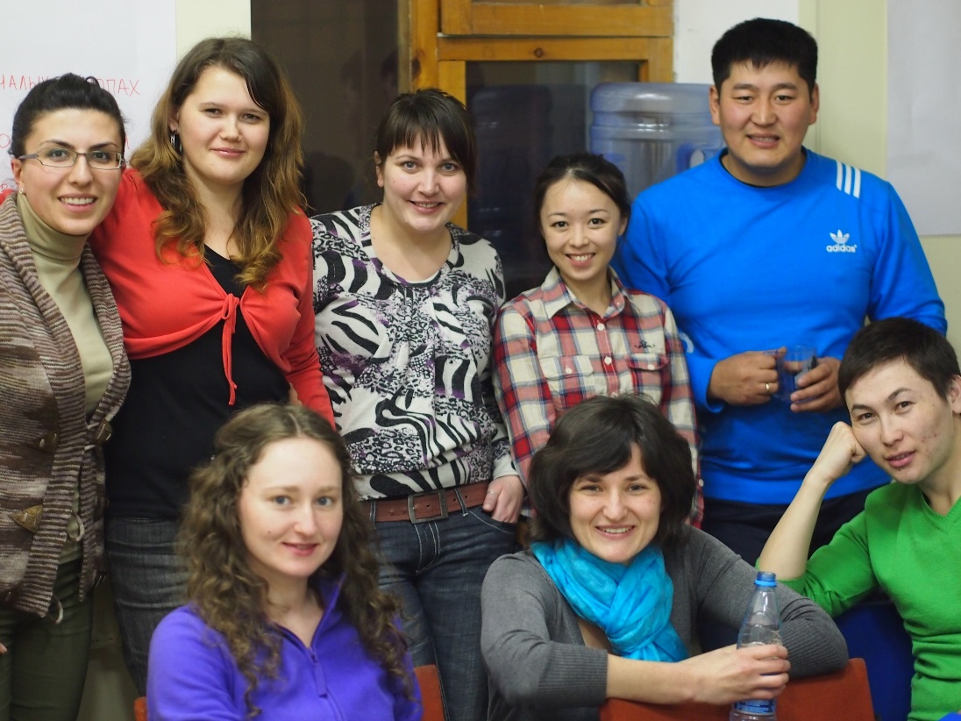
EURASIA – Bible & Life
HOW CAN YOU HELP?
GIVE:
To help cover the costs of students attending training weekends.
Cost: $25/student to attend
PRAY:
for God to continue to give perseverance to students when they face opposition from family and friends because of their faith in Christ;
for grace and wisdom to live lives of obedience in the midst of such difficulties;
for boldness to share Christ with other students and people in their context.
Notes:
Give
In Eurasia students usually have very little money to work with. So staff often need to raise money to cover most of the cost of students coming for weekend training. Until the money is raised there is uncertainty that the training will actually happen. So it is more difficult for students to plan and for staff to prepare. Part of our offering will help with some of the costs needed for the weekend trainings. It costs $25 for a student to attend!
Pray
for God to continue to give perseverance to students when they face opposition from family, friends and authorities because of their faith in Christ;
for grace and wisdom to live lives of obedience in the midst of such difficulties;
for boldness to share Christ with other students and people in their context.

